Slide 1
Image Thresholding
Changing value of element in to 255 (white) to it’s value crosses 150 and if not it will be changed to 0 (black)
img[img > 150] = 255
img[img <= 150] = 0
Predefined function is there for thresholding
cv2.threshold(<grayscaleimage>, threshold value, max value, threshold style)
Ex: cv2.threshold(gray, 128, 255, cv2.THRESH_BINARY)

Slide 2
Adaptive thresholding
In simple thresholding, the threshold value is global, i.e., it is same for all the pixels in the image. Adaptive thresholding is the method where the threshold value is calculated for smaller regions and therefore, there will be different threshold values for different regions.
In OpenCV, you can perform Adaptive threshold operation on an image using the method adaptiveThreshold() of the Imgproc class. Following is the syntax of this method.
adaptiveThreshold(src, dst, maxValue, adaptiveMethod, thresholdType, blockSize, C)

Slide 3
Adaptive Thresholding
This method accepts the following parameters −
src − An object of the class Mat representing the source (input) image.
dst − An object of the class Mat representing the destination (output) image.
maxValue − A variable of double type representing the value that is to be given if pixel value is more than the threshold value.
adaptiveMethod − A variable of integer the type representing the adaptive method to be used. This will be either of the following two values
ADAPTIVE_THRESH_MEAN_C − threshold value is the mean of neighborhood area.
ADAPTIVE_THRESH_GAUSSIAN_C − threshold value is the weighted sum of neighborhood values where weights are a Gaussian window.
thresholdType − A variable of integer type representing the type of threshold to be used.
blockSize − A variable of the integer type representing size of the pixelneighborhood used to calculate the threshold value.
C − A variable of double type representing the constant used in the both methods (subtracted from the mean or weighted mean).

Slide 4

Adaptive Thresholding
Assume that following is the input image thresh_input.jpg specified in the above program.

Slide 5




Adaptive Thresholding
adaptiveMethod / thresholdType | ADAPTIVE_THRESH_MEAN_C | ADAPTIVE_THRESH_GAUSSIAN_C:
THRESH_BINARY
THRESH_BINARY_INV

Slide 6
Bitwise operations on images
# Inverse of the image
Inv_img = cv2.bitwise_not(img)
# Bitwise And operation
bit_and = cv2.bitwise_and(img, img, mask)
# Bitwise Or between 2 images
bit_or = cv2.bitwise_or(img1, img2)

Slide 7
Image smoothing
Image smoothing is the process of removal of noise from an image.
This makes the image even, making it simpler for processing.
Image smoothing is mathematically obtained by using a low pass filter to the frequency domain of the image.
Example : Average Blur,Gaussian blur

Slide 8
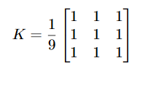
Average blur
This is done by convolving the image with a normalized box filter. It simply takes the average of all the pixels under kernel area and replaces the central element with this average
cv2.blur() or cv2.boxFilter() are used.
b = cv2.blur(img, (5, 5))

Slide 9
Task:
Use the gaussian blur function in openCV to study the blurring effects on a noisy image.

Slide 10
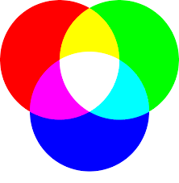
DIFFERENT COLOUR SYSTEM
Two popular colour systems are
1. RGB
2. HSV
RGB colour system
This is the commonly used in displays and experiments

Slide 11
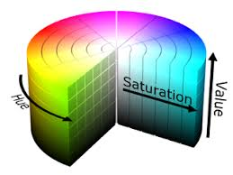
HSV
HSV is Hue Saturation Value.
Hue means the colour content. It is measured in degrees.
Saturation is the colour concentration of the specific colour.
Value means the Brightness concentration of the colour specified.

Slide 12
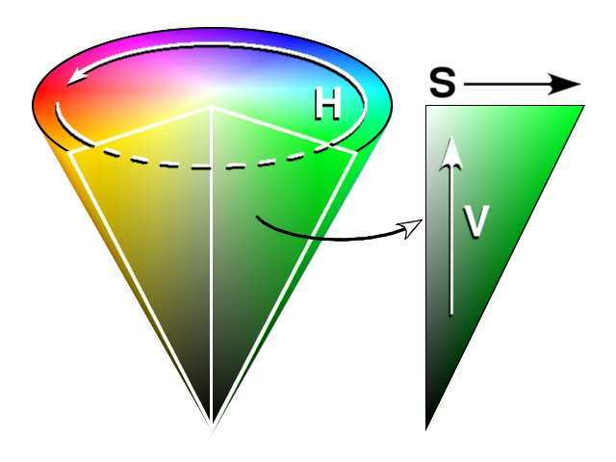
ADVANTAGE OF HSV OVER RGB
Using HSV becomes more convenient in image processing
In CV, since the intensity component differs with the brightness and hue depicts the colour we can manipulate only the hue component, without considering brightness
The combination of hsv is more interpretable than RGB

Slide 13
Range in hsv colour space
For object Tracking, setting range of colors in image is useful.
cv2.inRange() function is used for setting range.
lower_h = np.array([170, 70, 50]) #Lower limit for the red color in hsv image
upper_h = np.array([180, 255, 255]) #Upper limit for the red color in hsv image
lower_s = np.array([50, 120, 120])
upper_s = np.array([80, 255, 255])
lower_v = np.array([83, 120, 120])
upper_v = np.array([170, 255, 255])
mask = cv2.inRange(hsvimg, lower_h, upper_h) #Outputs mask of red color in hsv image

Slide 14
Contours in opencv
Contours is a curve joining all the continuous points (along the boundary), having same color or intensity.
cv2.findContours() is used to get contours of an image
im2, contours, hierarchy = cv2.findContours(thresh, cv2.RETR_EXTERNAL, cv2.CHAIN_APPROX_NONE)
thresh is grayscale or black and white image with threshold applied
contours is the list of all contours present in the given image

Slide 15
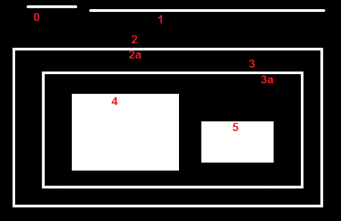
cv2.RETR_EXTERNAL
cv2.findContours() function might return multiple contours as in case of this image.
So using the flag cv2.RETR_EXTERNAL, leaves behind all the contours inside the largest bounding contour.
That is, it returns the outermost contour found in the image.

Slide 16
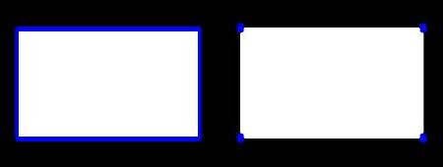
cv2.CHAIN_APPROX_NONE
CV_CHAIN_APPROX_NONE
Used for all the contour points.
The contour points will be in the neighbourhood of the pixels.
CHAIN_APPROX_NONE
CHAIN_APPROX_SIMPLE

Slide 17
Drawing Contours
Contours extracted by the cv2.findContours() function can be drawn on an image by using cv2.drawContours() function.
cv2.drawContours(img, contours, idx, color, thickness)
# To draw all the contours at once:
cv2.drawContours(img, contours, -1, (0,255,0), 3)
# To draw 4th(say) contour:
cv2.drawContours(img, contours, 3, (0,255,0), 3)

Slide 18
Contours Properties
Contour Area:
-Contour area is given by the function cv2.contourArea()
area = cv2.contourArea(cnt)
Contour Perimeter:
-It is also called arc length.
-It can be found out usingcv2.arcLength()function.
perimeter = cv2.arcLength(cnt, True)

Slide 19
Contours Properties
Moments:
- help you to calculate some features like center of mass of the object, area of the object etc.
From this moments, you can extract useful data like area, centroid etc. Centroid is given by the relations.
. This can be done as follows:
M = cv2.moments(cnt)
cx = int(M['m10']/M['m00'])
cy = int(M['m01']/M['m00'])

Slide 20
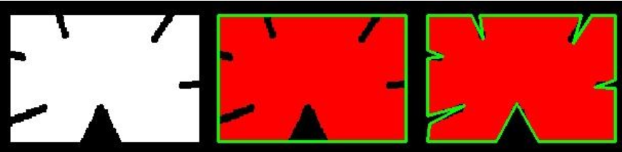
Contour properties
Contour Approximation:
- It approximates a contour shape to another shape with less number of vertices depending upon the precision we scontourpecify.
“epsilon” is maximum distance from to approximated contour.
epsilon = 0.1*cv2.arcLength(cnt,True)
approx = cv2.approxPolyDP(cnt,epsilon,True)

